Slide 1
Custom Marker Recognizer 15-494 Final Project
Dhruv Khurana (dkhurana)

Slide 2
Index
Slide 3: Objective
Slide 4: Methods Attempted
Slide 8: Implementation Logic Overview
Slide 11: Implementation Logic Explanations
Slide 19: Parameters
Slide 20: Biggest Challenges
Slide 21: Most Interesting Aspect
Slide 22: Future Extensions
Slide 24: Screenshots

Slide 3
Objective
Create custom markers, based on line drawings, and have the Cozmo recognize said markers in a scene, based on 1 or a small number of template images.
Have the markers be recognizable even with varying distances and some shear and skew.
Not intended to recognize markers with noticeable amounts of rotation compared to template image, or markers too far from camera.

Slide 4
Methods Attempted
Haar Classifiers
Digital Image features often used in image detection, especially for detecting faces.
Work by comparing pixel intensities in different subsections of an image.
Working Haar classifier generated, but did not work with line drawings, due to lack of continuous gradation between different parts of an image in line drawings.

Slide 5
Methods Attempted
Neural Network
Convolutional Neural Network written using Keras.
Positive image dataset generated based on template image in 2 ways:
Image transformations (rotations, shearing, translation, erode, dilate)
Placing template image in front of already stored background images with transformations (rotations, shearing , translation)
Placing template image in front of background images achieved 75% accuracy with a 2 layer CNN. Image transformations achieved significantly worse <50% results.
Neural Network designed to take <10 minutes to train with minimal data. Higher accuracy can probably be achieved with more data and deeper network.

Slide 6
Methods Attempted
Neural Network
Implemented bounding boxes by classifying subsections of image, then percolating results up to larger bounding boxes for better bounding box tracking.
Higher accuracy with rotated markers than other methods.
Ultimately abandoned due to lack of sufficient accuracy for real world use, especially over template matching.

Slide 7
Methods Attempted
Multiscale Template Matching
Implemented using Canny Edge detection and matching with template edges.
Implemented multiscale detection to detect markers at varied distances.
Implemented robust tunable methods to detect presence of multiple markers, and lack of markers in a scene.
Tunable parameters allow detection even in cases of extreme closeness in markers in scene, where bounding boxes overlap.
Finally chosen and completely implemented method due to high robustness with skew transformations and translations.

Slide 8
Methods Attempted
Multiscale Template Matching
Not designed to detect markers with noticeable rotation.
Improves upon lab 7 by allowing matching of templated without closed outermost contours.
Also takes all edges in template, instead of specific contours into consideration.
Allows creation and detection of different markers (such as emoji faces), with same outermost contour.

Slide 9
Implementation Logic Overview
Template image is taken from marked region of camera at the time of user input, and converted to gray.
Template has its edges detected. Output map is then resized to 50 by 50 pixels, and saved to local file. Subsequent calls to function can choose to utilize this already stored template.
New image from camera is taken for detection and converted to gray.
Image is scaled from 0.2 times to 1.0 times its original size for comparison to template.
For every resized image, edges are taken and then matched to template.

Slide 10
Implementation Logic Overview
All subsections over all scales that have a confidence of over the threshold passed as argument to the function have their bounding boxes stored.
non_max_suppression_fast(boxes, overlapThresh) takes these bounding boxes and combines them based on the overlap threshold (1 = take all boxes, 0 = combine for any overlap).
For every independent box returned from non_max_suppression_fast(boxes, overlapThresh), we run the template matching algorithm again and pick the best match out of them.

Slide 11
Implementation Logic Explanations
Template has its edges detected. Output map is then resized to 50 by 50 pixels
50 by 50 chosen since our scaled test images have minimum size of 64 by 48.
Marked region is 100 by 100 pixels, and so 1:1 aspect ratio. We downscale to 50 by 50 to allow for detection of smaller markers.
Does not have a noticeable decrease in accuracy, unless marker has multiple lines extremely close to each other. In that case, the marker is not well designed since lines would merge at distances anyway.
Smaller scale sizes lose information and increase false positives. Larger scale sizes miss markers further away.

Slide 12
Implementation Logic Explanations
Image is scaled from 0.2 times to 1.0 times its original size for comparison to template.
We use np.linspace() to generate scales. Currently set to 20 for balance of speed and accuracy. Can be increased to increase accuracy at cost of speed and vice versa.
Minimum Image scale is 0.2 since we are working with Cozmo. So 0.2 makes 64x48 which is approximately the size of our template.
We keep our upper limit on scale to 1.0 since we want to avoid interpolation when upscaling image. In case we want to detect tags that are far enough that they don’t fit into 50 by 50 pixels in the camera, we can change the resized template size to something even smaller, such as 20 by 20 (check screenshots). However, accuracy decreases, since edgelines can merge.

Slide 13
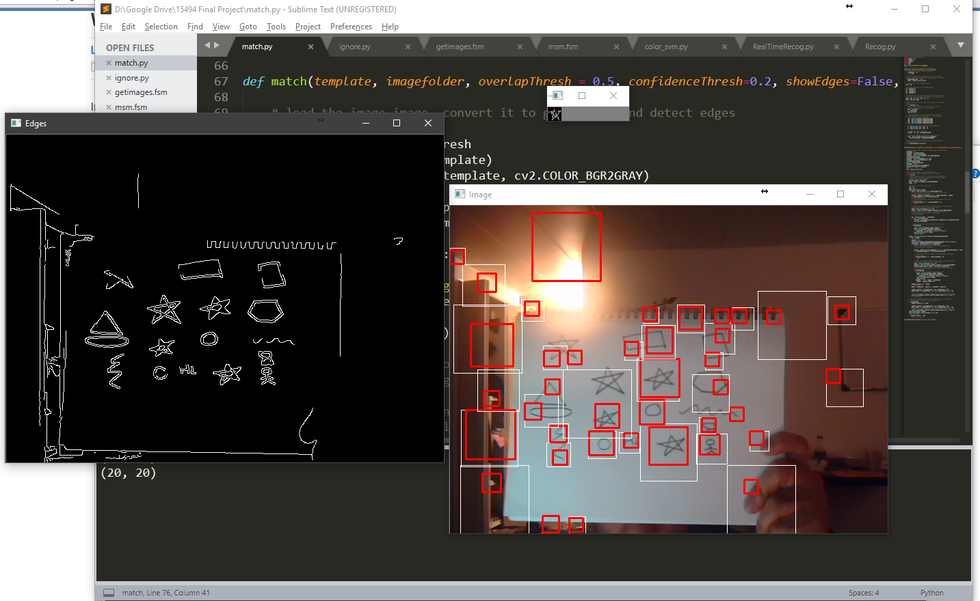
Screenshots: Changing template size to 20x20 (not recommended)

Slide 14
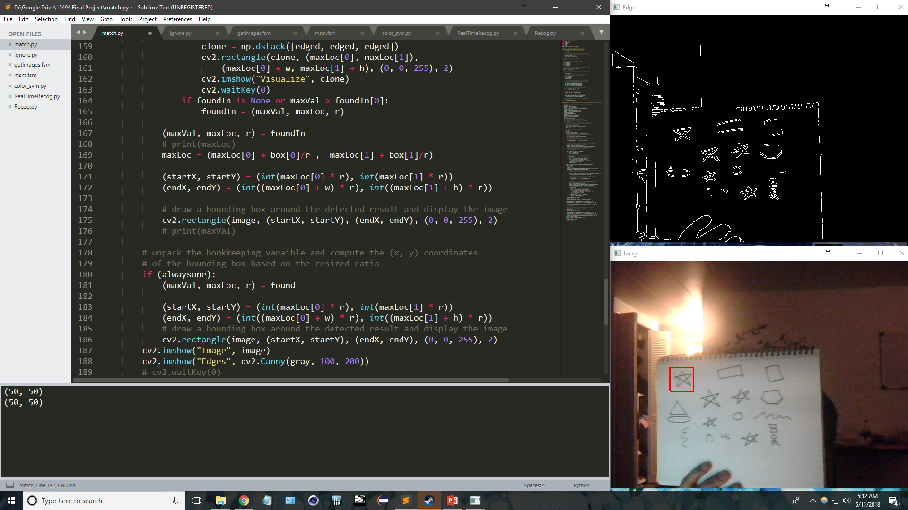
Screenshots: Markers too far, edge information partially lost

Slide 15
Implementation Logic Explanations
For every resized image, edges are taken and then matched to template.
We match the template to the image using cv2.matchTemplate(edged, template, cv2.TM_CCORR_NORMED)
Our options for comparison methods which could reasonably implement thresholding were cv2.TM_CCOEFF_NORMED , cv2.TM_CCORR_NORMED , cv2.TM_SQDIFF_NORMED (Normed methods make thresholding easier).
cv2.TM_SQDIFF_NORMED had a large number of false positives and was extremely slow.
cv2.TM_COEFF_NORMED was decently accurate and reasonably fast.
Cv2.TM_CCORR_NORMED performed the best in terms of matching, especially for poorer quality templates than other methods. It was also about the same speed as cv2.TM_COEFF_NORMED in testing.

Slide 16
Implementation Logic Explanations
All subsections over all scales that have a confidence of over the threshold passed as argument to the function have their bounding boxes stored and then sent to non_max_suppression_fast(boxes, overlapThresh)
The multiscale matcher can generate hundreds of bounding boxes (average number of boxes per scale * number of scales)
non_max_suppression_fast() takes the coordinates for all bounding boxes and gives the boxes that combine all sets of independent, partially overlapping boxes, based on how much percentage overlap do boxes have to have before they are combined (overlapThresh).

Slide 17
Implementation Logic Explanations
All subsections over all scales that have a confidence of over the threshold passed as argument to the function have their bounding boxes stored and then sent to non_max_suppression_fast(boxes, overlapThresh)
This allows for combining multiple boxes that mark the same detection in multiple scales into one.
Also, allows finetuning in case markers are sufficiently close such that they cannot have non-overlapping bounding boxes (should not occur in the intended application of markers, but helps for more general cases of multiple markers on non-rigid bodies such as clothes).
NOTE: non_max_suppression_fast() is a preexisting algorithm and not my implementation

Slide 18
Implementation Logic Explanations
For every independent box returned from non_max_suppression_fast(boxes, overlapThresh), we run the template matching algorithm again and pick the best match out of them.
Runs the template matching algorithm on the subimages marked by the boxes.
Step primarily done to get tighter bounding boxes.
Can be completely skipped if user is fine with somewhat reduced precision for location of markers.

Slide 19
Parameters
For msmFinal.fsm
def Classify(self, confidenceThresh=0.2, overlapThresh = 0.5):
confidenceThresh: Primary tuneable parameter. Recommended values 0.1-0.35 for hand drawings. Upto 0.6 for printouts of same marker.
overlapThresh: Percentage over which bounding boxes should be combined. Ideally should be very low (<0.2), but can be increased if markers very densely packed (if markers cannot have non-intersecting bounding boxes).

Slide 20
Biggest Challenges
Figuring out the right method to achieve objective.
Significant time spent in creating working code for making haar-cascade and neural network based solutions, which did not achieve objective with sufficient robustness and accuracy.
Combining multiscale matching with matching multiple items / no items in test image.
For a single occurrence, we can simply find the best match to the template in the image. However, multiscale matching creates a large number of bounding boxes for the same marker. Similarly, best match is incorrect if no matching marker exists in image.
No match solved by thresholding the result. Large number of bounding boxes solved by using non_max_suppression_fast().

Slide 21
Most Interesting Aspect
No preexisting information on recognizing custom images that are not an exact match to target image / subsection of image, except for using haar classifiers and neural networks (hence the missteps).
Solution allows any arbitrary image (with identifiable edges), to be found in any other image, and is not restricted by size or count or even exactness. Thus, it can detect any hand drawn markers reasonably similar to the template.

Slide 22
Future Extensions
Combine haar cascade implementation with Cozmo code to allow it to detect arbitrary real world items in an image.
Apply filters to sharpen edges of both template and input images.
Allow detection to work robustly over a real-time video.
While it can currently work on a livestream, even the slightest movement can cause it to temporarily lose the detections. This can, however, be rectified using an improved camera, but is not applicable to the Cozmo. For this reason and the processing time required for every frame, it is not recommended to run this as a livestream on Cozmo, unless a separate thread can be created for the vision work.

Slide 23
Future Extensions
Allow threshold adjustment in realtime.
Currently the program needs to be stopped to change threshold values for detection and bounding box overlap. For a livestream, while a trackbar can be added to the GUI, attempting to read its value, either directly or via callback function causes hangs.
Dynamic thresholding
Changing the thresholding based on lighting conditions of the scene. Thresholding currently needs to be manually adjusted for every scene and lighting condition.
Note: Recommended values for confidence threshold are 0.15 – 0.35.

Slide 24
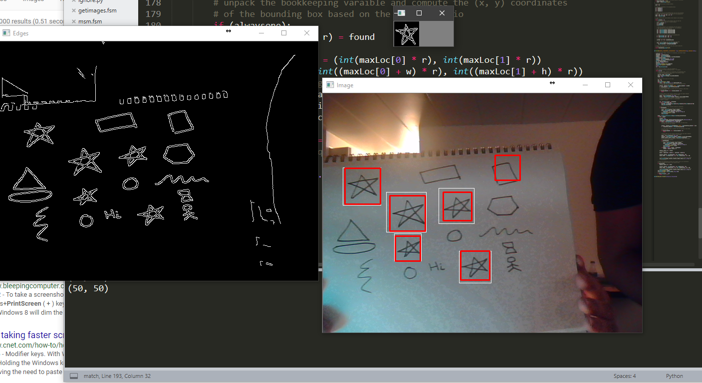
Screenshots: Program in Action

Slide 25
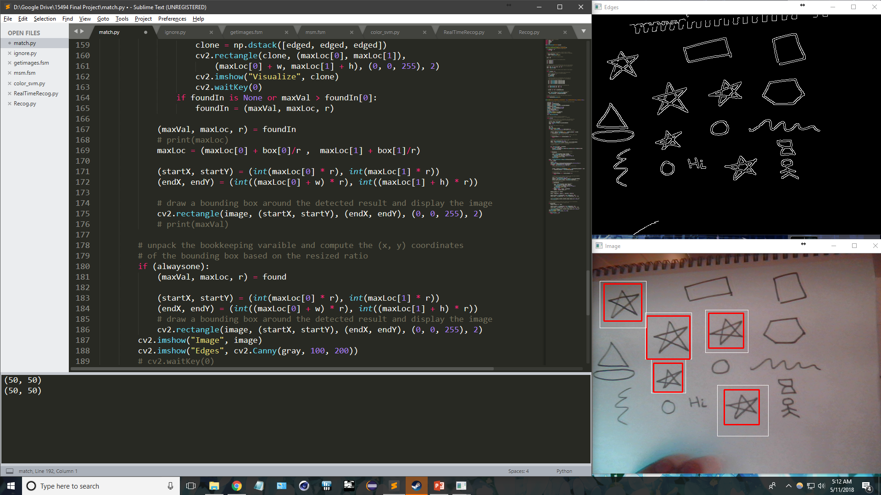
Screenshots: Program in Action

